Slide 1
Biogeochemical cycling of matter
Biogeochemical cycling
A biogeochemical cycle is a model describing how chemical elements (e.g. nitrogen, carbon) or molecules (e.g. water) are transformed and stored in both biological and geological components of Earth’s biosphere. Biogeochemical cycles show the pathways of matter through the living components (organisms) and non-living components (such as soils, rocks, water and the atmosphere) of an ecosystem. These chemicals are recycled through biological food webs and through geological processes, such as weathering and erosion and volcanic activity

Slide 2
Biogeochemical cycling of matter
The carbon cycle
Carbon is in all organic matter, including carbohydrates, lipids, proteins and nucleic acids, which are the chemical building blocks of cells and the source of their energy.
 | CARBON
Carbon is constantly moving between different forms. It is stored in reservoirs, and it moves between these reservoirs through a variety of processes, including photosynthesis the burning of fossil fuels and the release of breath from the lungs. The carbon cycle is the biogeochemical cycle by which carbon is exchanged between the biosphere, geosphere, hydrosphere and atmosphere of Earth.

Slide 3
Biogeochemical cycling of matter
The carbon cycle
We noted earlier that energy is lost along food chains through the production of organic wastes such as faeces and dead tissues. However, the matter comprising this detritus is not necessarily lost to the ecosystem.
Detritivores, such as worms, feed on plant detritus and scavengers feed on the dead carcasses of animals.
Decomposers break down complex organic matter into simple inorganic molecules (nutrients). In this way, the organic matter is recycled and re-enters the food chains via producers. Fungi and bacteria are common decomposers.

Slide 4
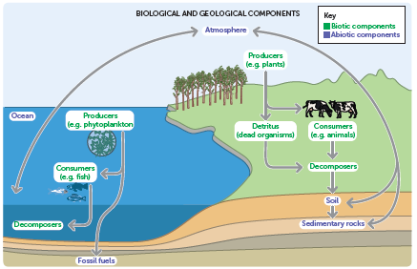
Biogeochemical cycling of matter
The carbon cycle
Matter cycles between the biotic components (such as food webs) and abiotic components (including soil, rock, water and atmosphere) of an ecosystem. This means matter moves through the biological and geological components of Earth as different chemical forms.

Slide 5
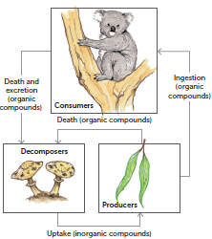
The carbon cycle
Biogeochemical cycling of matter
The relationship between producers, consumers and decomposers. Each member of the food chain can absorb organic compounds as the products, by-products or waste material of another member.

Slide 6
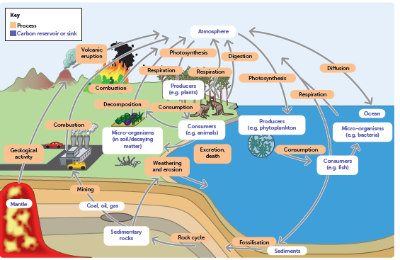
The carbon cycle
Biogeochemical cycling of matter
The carbon cycle. Atmospheric carbon dioxide is trapped by autotrophic organisms and incorporated into carbohydrates during photosynthesis. This carbon-rich biomass is consumed by members of the food chain and provides energy and matter. Carbon is released into the atmosphere as carbon dioxide from cellular respiration and the combustion of fossil fuels.

